Slide 1
Turing Machines
(Part-I)
Ege University Computer Engineering Dept.
Automata Theory
2011-2012 Fall

Slide 2
Formal Definition of Turing Machine (T.M.)
T.M. is a collection of six things:
  An alphabet of input symbols (It does not contain blank (Δ) symbol.)
  A tape divided into a sequence of numbered cells, each containing one character or a blank.

Slide 3
Formal Definition of Turing Machine (T.M.)
T.M. is a collection of six things:
  A tape head that can in one step read the contents of a cell on the tape, replace it with some other character, and reposition itself to the next cell to the right or to the left of the one it has just read. At the start of processing, the tape head always begins by reading the first cell. The tape head can never move left from the first cell.

Slide 4
Formal Definition of Turing Machine (T.M.)
  An output alphabet characters of which can be printed on the tape by the tape head. Blank (Δ) can be in output alphabet (for example for deleting the cell content). Output alphabet can include all or some of the symbols of the input alphabet, or it can be entirely different.
  A finite set of states including exactly one START state from which we begin execution and some HALT states.

Slide 5
Formal Definition of Turing Machine (T.M.)
  A program, which is a set of rules that tell us, on the basis of the state we are in and the letter the tape head has just read, how to chage states, what to print on the tape, and where to move the tape head. We depict the program as a collection of directed edges connecting the states. Each edge is labeled with a triple of information;
  (symbol, symbol, edge)

Slide 6
Formal Definition of Turing Machine (T.M.)
  The first letter of the triple is the character the tape head reads from the cell to which it is pointing. The second letter is what the tape head prints in the cell before it leaves. The third component tells the tape head whether to move one cell to the right, R, or one cell to the left, L.

Slide 7
T.M. Program
Current State Symbol Read Next State Symbol Written Direction
Q1 a Q2 b L
Q1 b Q3 a R
We usually use a state transition diagram as below:
Q2
(a,b,L)
Q1
Q3
(b,a,R)

Slide 8
Example-1
Write a R.E. and then build a FA for the language having words with second letter b. (Alphabet={a,b}) Finally, build a T.M. that accepts the same language.
  R.E.: (a+b)b(a+b)*
a,b
a,b
b
1-
2
3+
=>FA

Slide 9
Example-1: T.M.
(a,a,R)
(b,b,R)
(a,a,R)
(b,b,R)
Start
2
3
Halt
(Δ,Δ,R)
(b,b,R)
*Since TMs can recognize regular languages, we can build a TM for a regular
language.
**Can you propose a informal method for converting a FA to a T.M ?

Slide 10
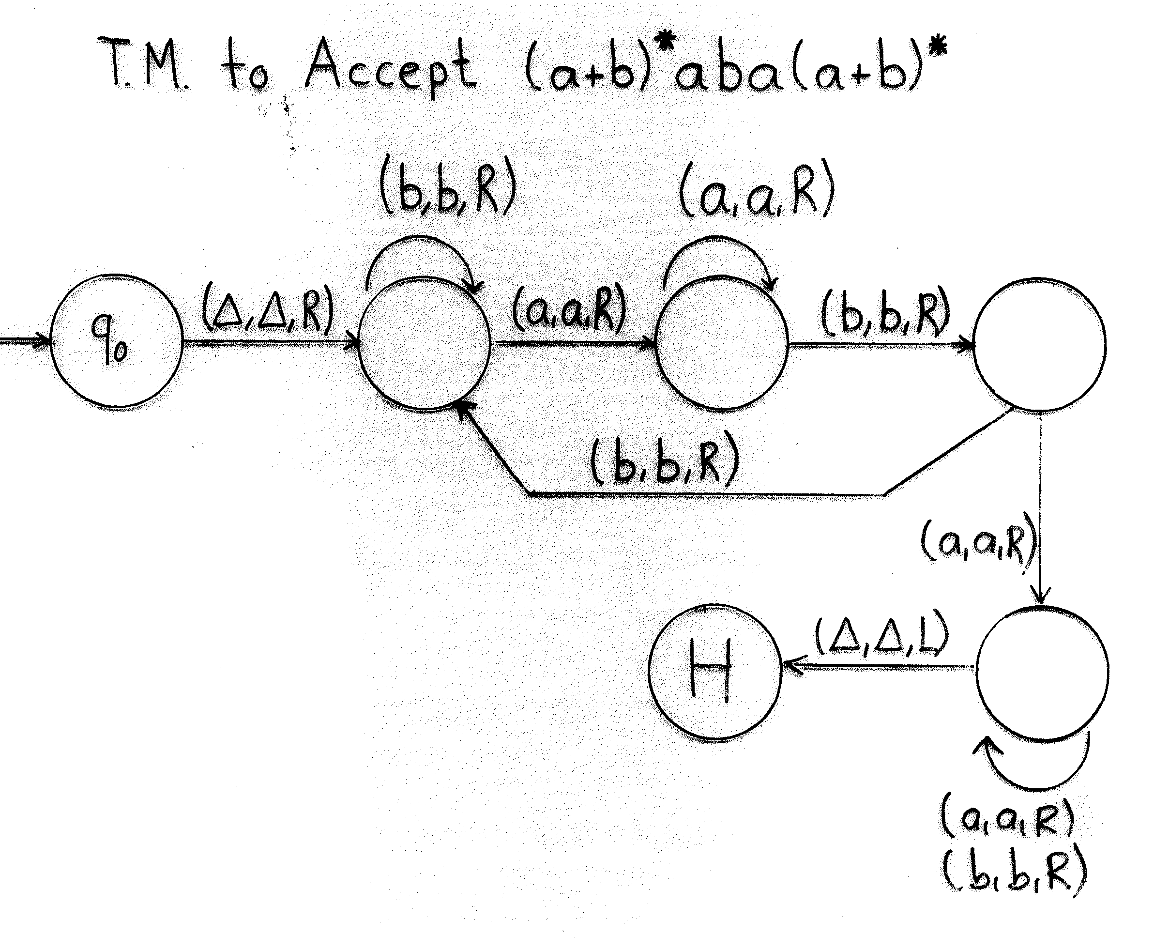
Example-2
Note: A BLANK symbol is assumed to exist at the begining of
the input string, but this is a special case for this question.
Please, do not assume that an input string begins with a BLANK
unless you are told to do so.

Slide 11
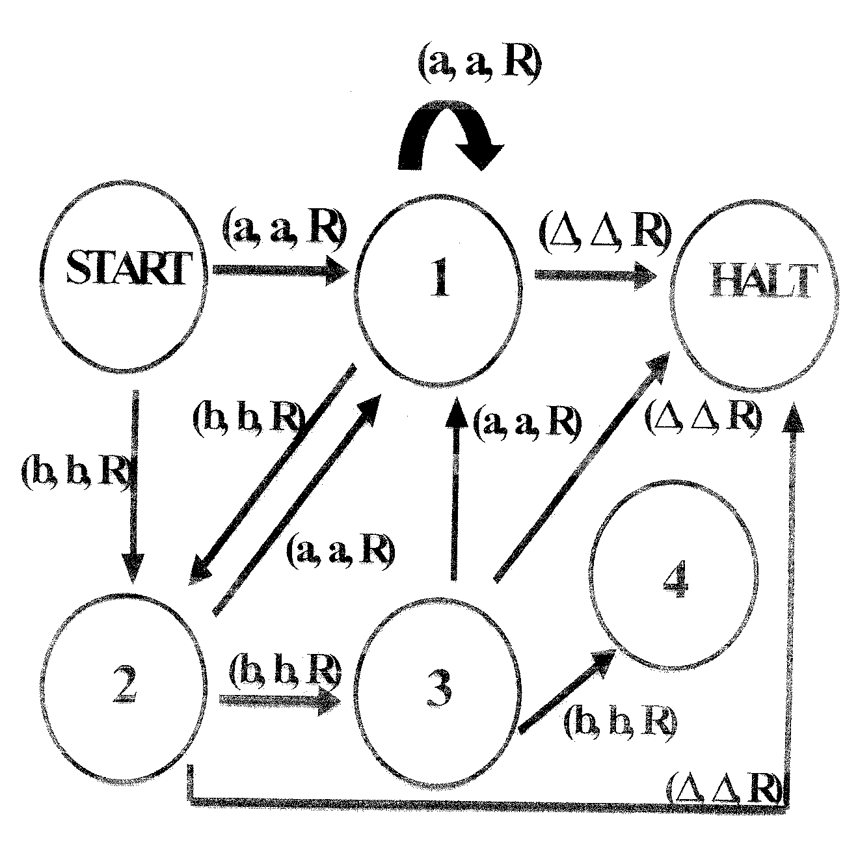
Example-3: T.M. for the language of words that do not contain bbb.

Slide 12
Example-4
L:a^{n}b^{n} is a non-regular language. We have already proven using “Pumping Lemma”.
Build a TM for L.and write the execution chain for the word aabb. Before drawing the state transition diagram, you have to explain your design.

Slide 13
Example-4 (cont.)
(B,B,R)
(a,a,R)
(B,B,L)
(B,B,R)
(a,A,R)
(b,B,L)
(A,A,R)
Start
2
3
5
(Δ,Δ,R)
(A,A,R)
4
(a,a,L)
Halt
(a,a,L)

Slide 14
Example-4 (cont.)
Execution Chain:
  Start 2 2 3
  aabbΔ => AabbΔ => AabbΔ => AaBbΔ =>
  4 Start 2 2
  AaBbΔ => AaBbΔ => AABbΔ => AABbΔ =>
  3 3 5 5
  AABBΔ => AABBΔ => AABBΔ => AABBΔ =>
  5 Halt
  AABBΔ => AABBΔΔ

Slide 15
Definition
Every TM over an input alphabet divides the set of input strings into three classes:
  ACCEPT(TM) is the set of all strings leading to a HALT state. This is also called the language accepted by T.
  REJECT(T) is the set of all strings that crash during execution by moving left from cell 1 or by being in a state that has no exit edge that wants to read the character the tape head is reading.
  LOOP(T) is the set of all other strings, that is, strings that loop forever while running on T.

Slide 16
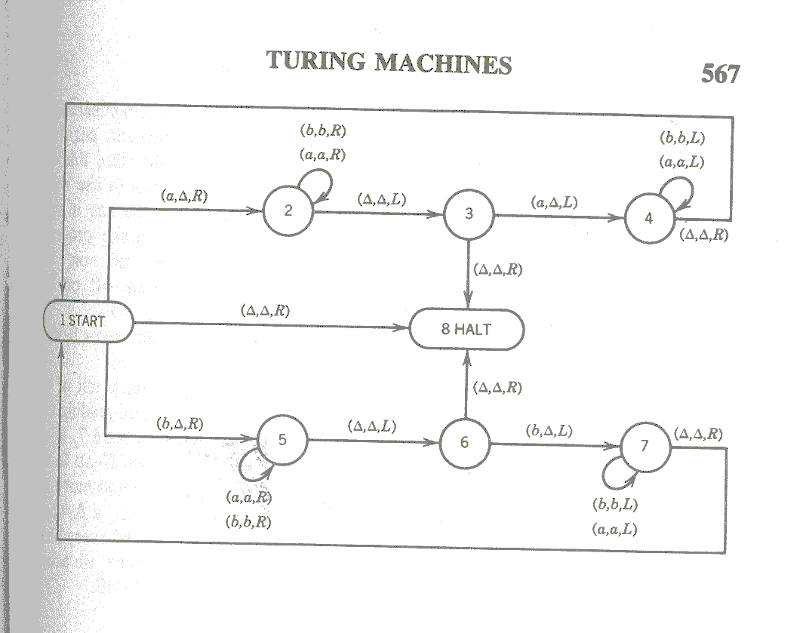
Example-5: T.M. for Palindrome

Slide 17
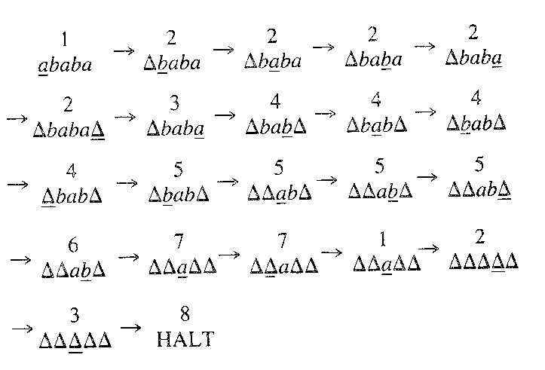
Palindrome – Execution Chain

Slide 18
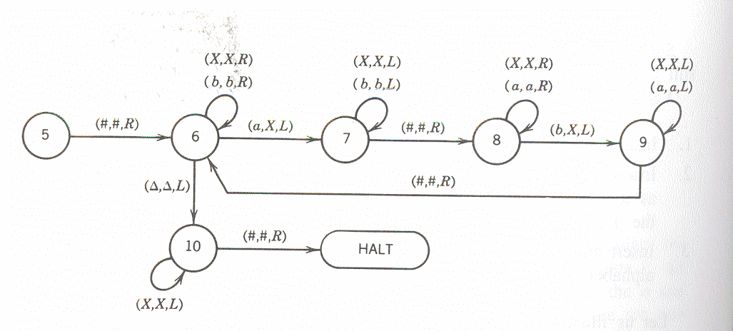
Example-6: T.M. for Language Equal

Slide 19
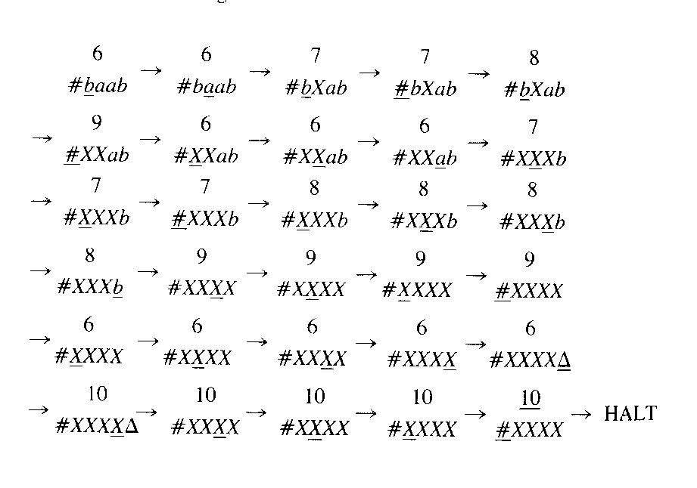
Execution Chain for Equal TM

Slide 20
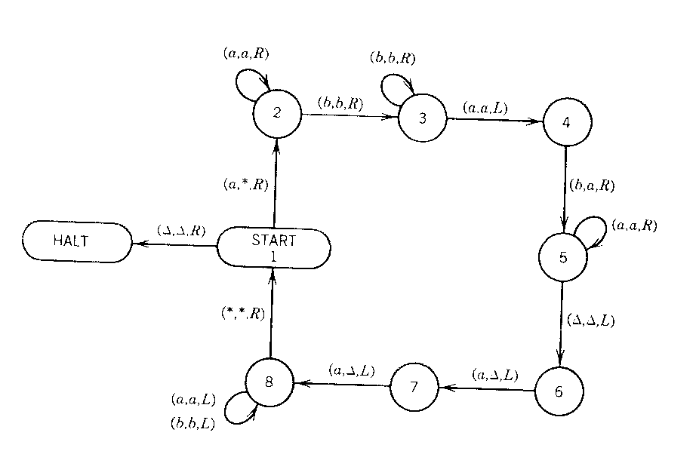
Example-7: T.M. for a^{n}b^{n}a^{n}

Slide 21
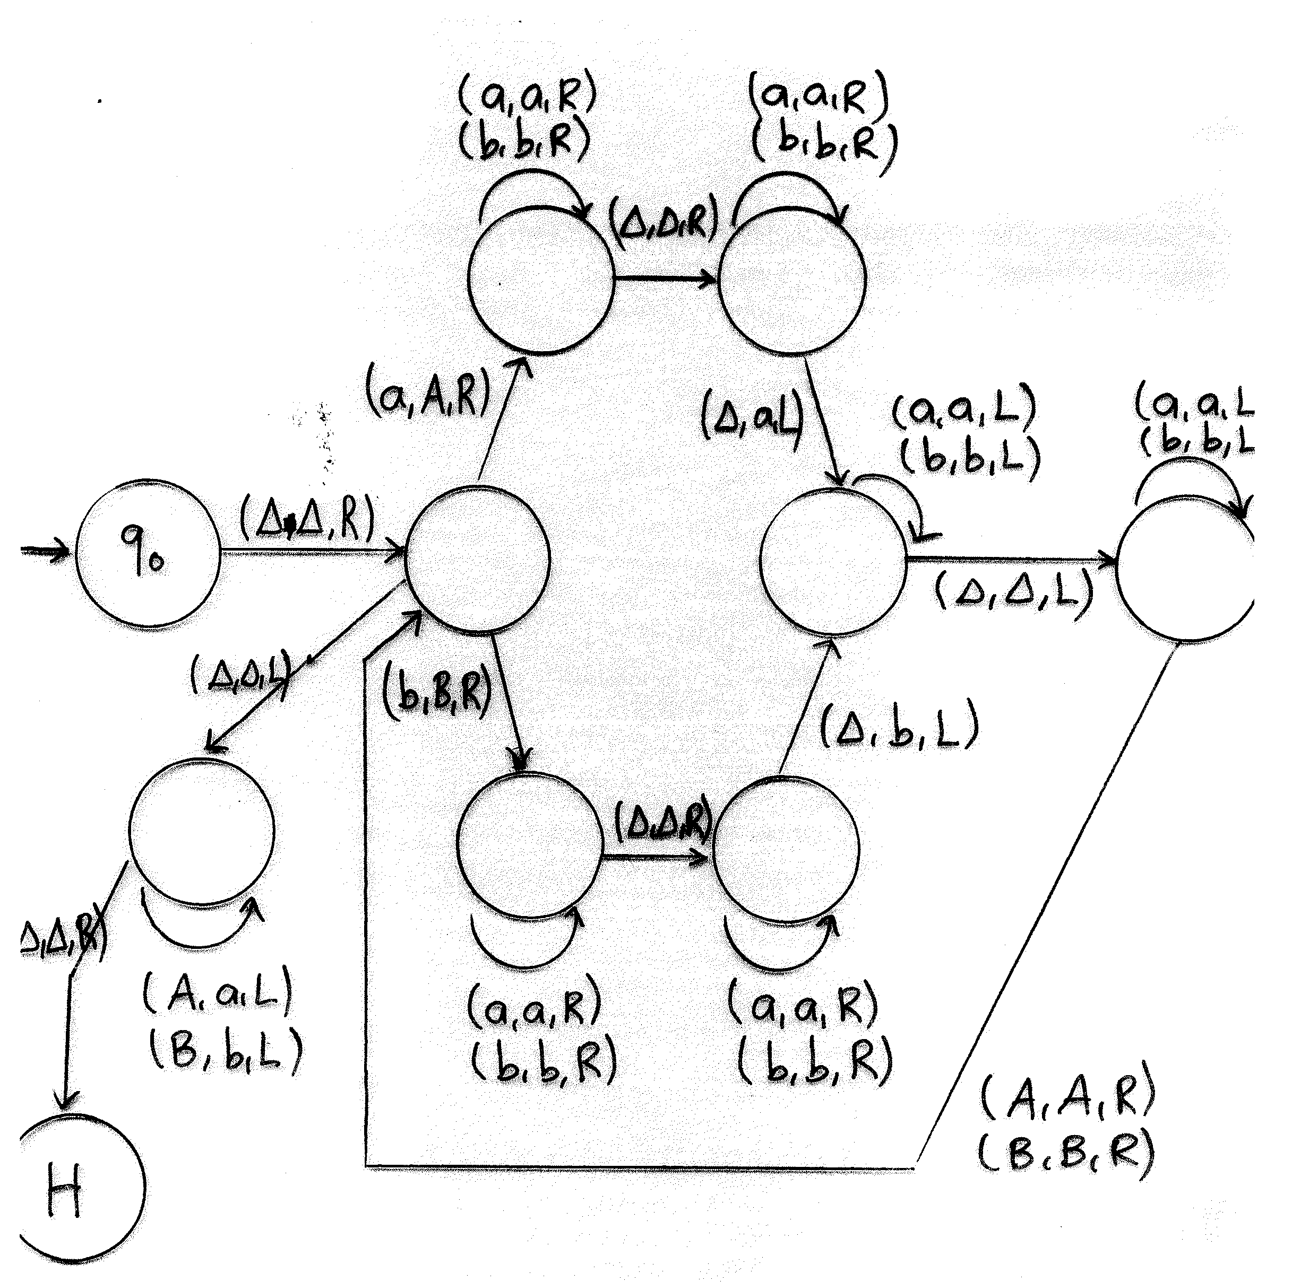
T.M. for “String Copying”

